Slide 1
STAT628 Yelp Data :
Taco Restaurant
Group 20: YUANHAO GENG, XUELAN QIAN, ZHANPENG XU, XINYU LI

Slide 2
Data prepare: Business Json File
Attributes:
Ordered value with n levels → integers from 0 to n-1
Unordered value → one-hot encoding
Bool value → 0 or 1
Notes:
There are 3 features: hours, categories and attributes in business.json file that we think might have relationship with the rating of taco restaurants.
exclude any restaurants with one or more na value of these three features.

Slide 3
Hours:
Whether it is open on weekends (bool 0 or 1)
Total weekly business hours (numerical)
Categories → Multi-hot encoding(other characteristics about taco restaurant):
Sports
Mexican
…

Slide 4
Missing value
Train a Random Forest model to impute missing values of the variables
Round to nearest integers

Slide 5
Fit a linear regression model
Ratings ~ Attributes + Categories + Hours
Significant variables (p-value < 0.05):
Attributes: Alcohol(-), Bike Parking(+), Drive Thru(-), Outdoor Seating(+), Restaurants Delivery(-)
Categories: Fast Food(-), Arcades(-), Arts & Entertainment(+), Honduran(-), Sandwiches(+)

Slide 6
Hours: Weekends(+)
Advices:
Provide bike parking and outdoor seating
Avoid being defined as Fast Food, Arcades and Honduran in categories when selling Tacos
Run business on weekends
Weakness: One hot encoding + Linear regression = Multicollinearity

Slide 7
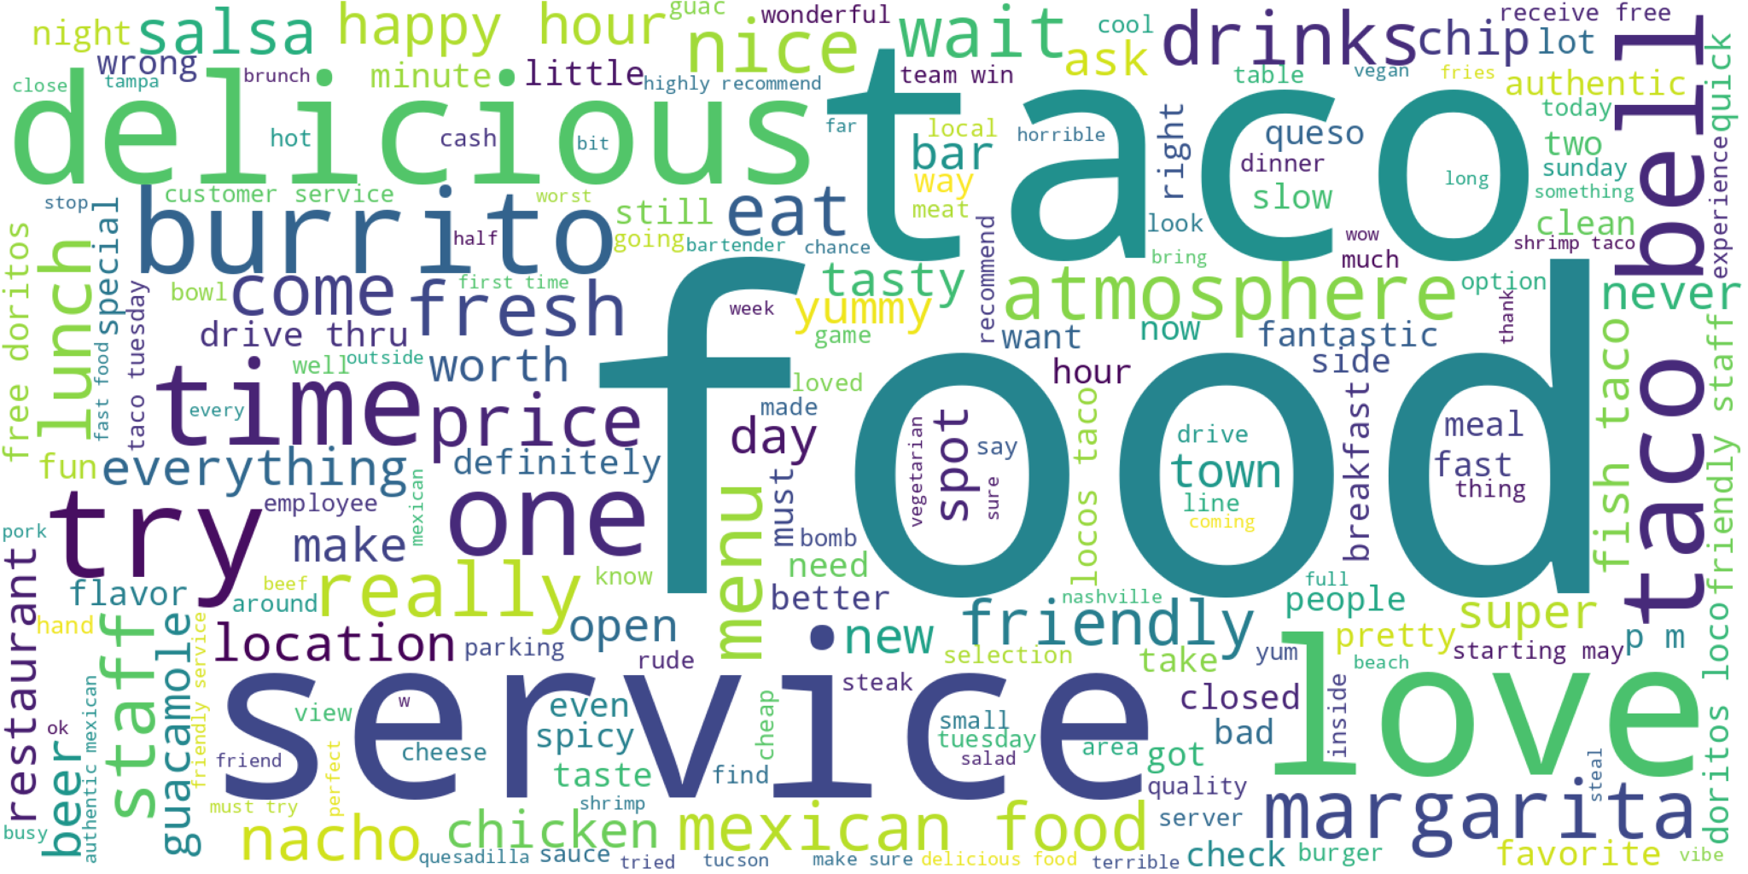
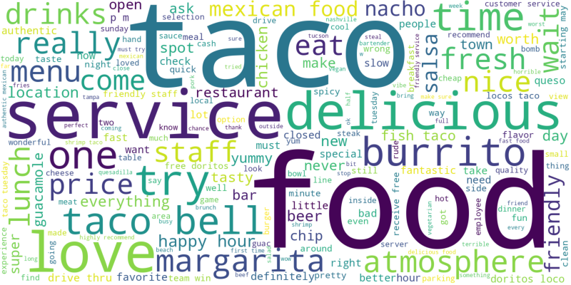
Word cloud of tips
Menu
  Types
  Sauces
Service
Atmosphere

Slide 8
Distribution of Specific Words in Reviews
We first do a sanity check with words we know are associated with bad (or good) ratings
Then we examine different dishes of taco and how they are related to ratings from two aspects: main materials and sauce
Finally we consider terms associated with service and with ambiance matters

Slide 9
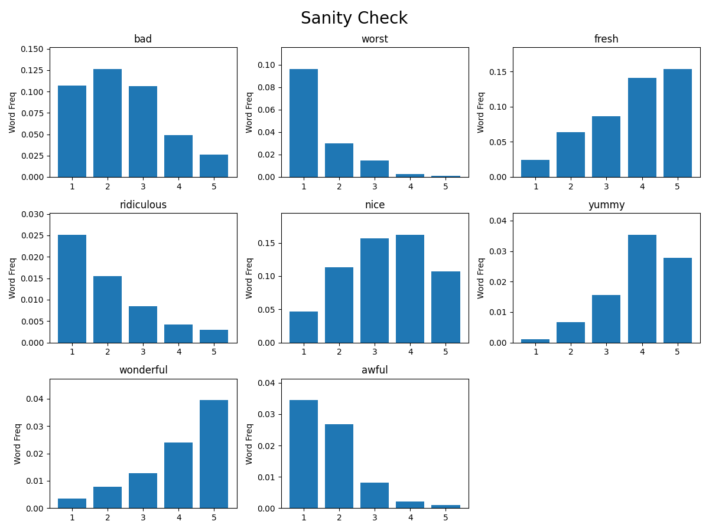

Slide 10
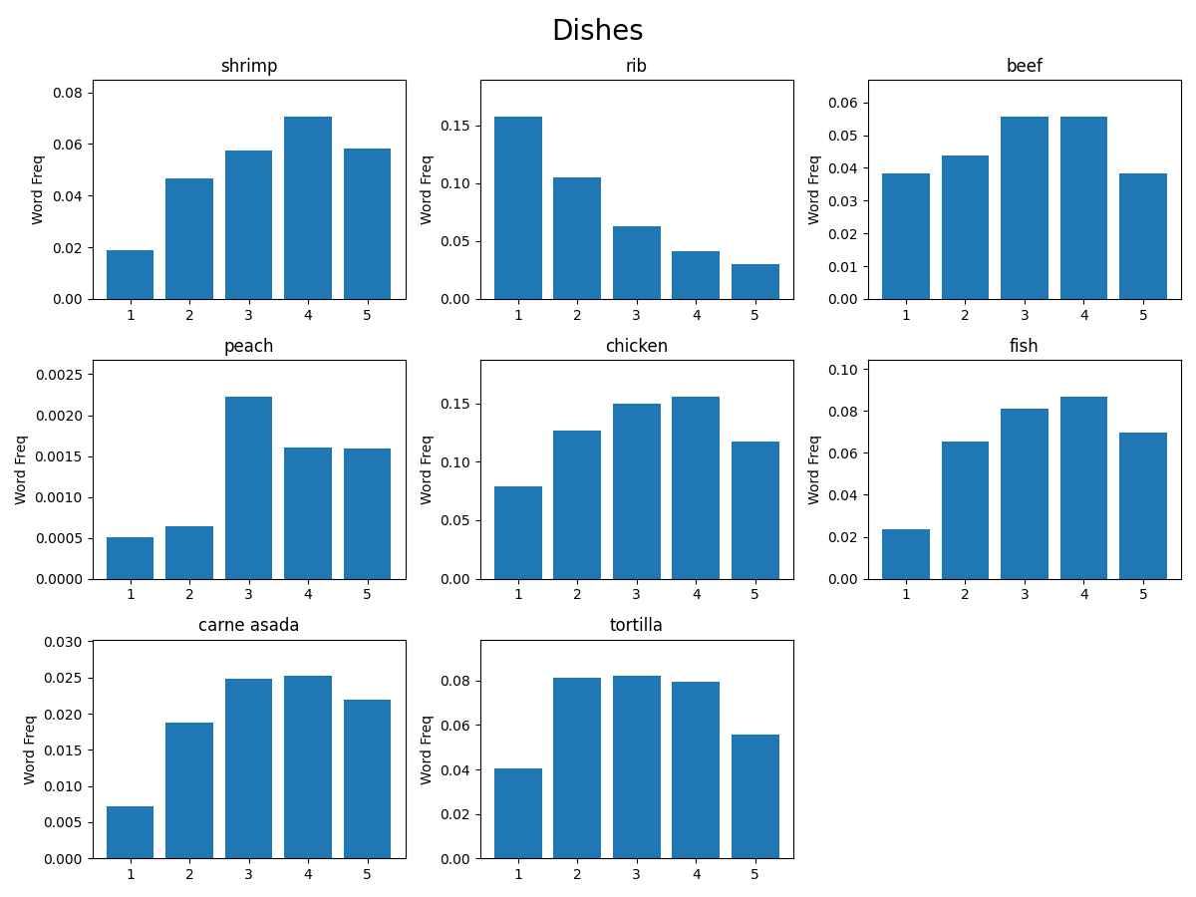

Slide 11
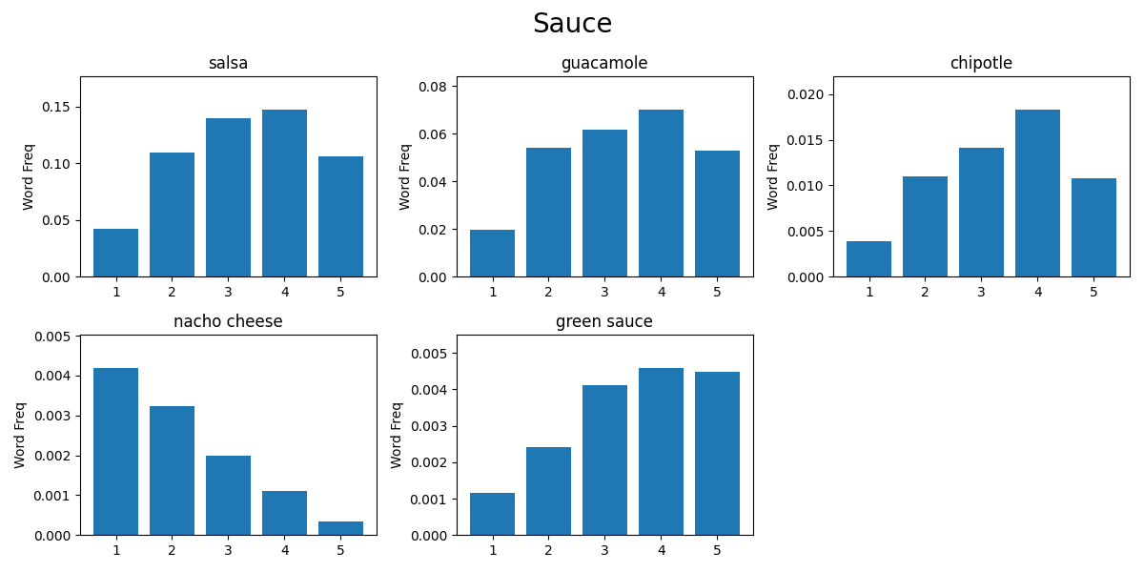

Slide 12
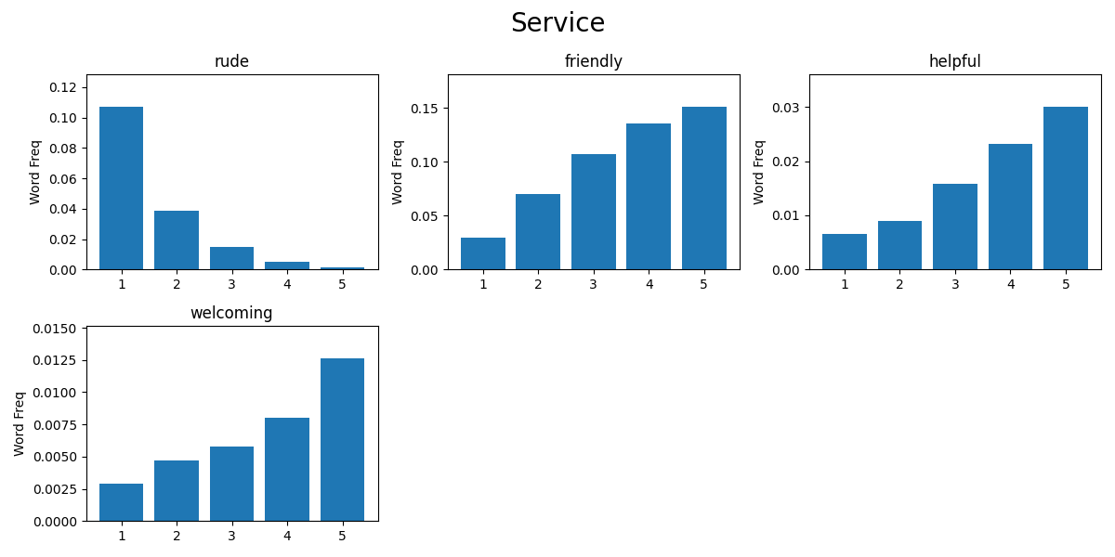

Slide 13
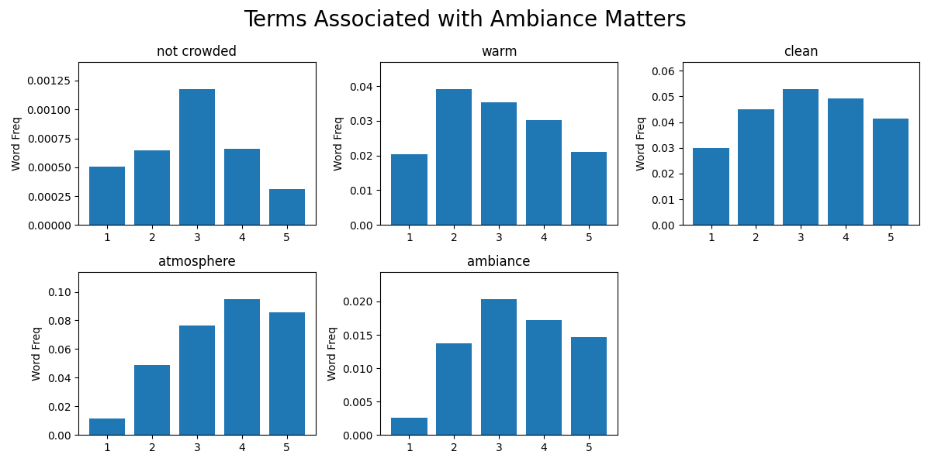

Slide 14
Distribution of Specific Words in Reviews
Potential hypotheses for ideal taco restaurant:
Dishes: Which types of taco would be more popular: shrimp, rib, or beef?
Sauce: salsa, guacamole, or nacho cheese?
Service: not rude, friendly, welcoming service would makes place more likely being praised.
Ambiance: warm, clean ambiance may be helpful for populazing.

Slide 15
Distribution of Specific Words in Reviews
Other aspects:
Consider per state situation to give more specific conclusion for business owner
statistical testing using goodness-of-fit test:
H_0: proportion of words per each star = proportion of reviews per each star
H_1: proportion of words per each star ≠ proportion of reviews per each star

Slide 16
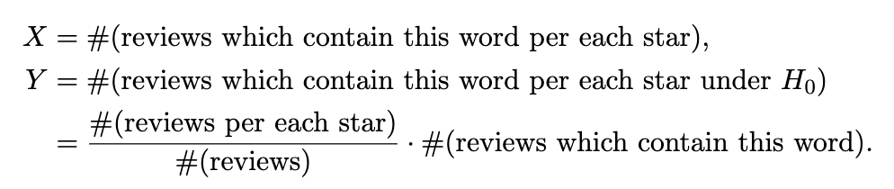
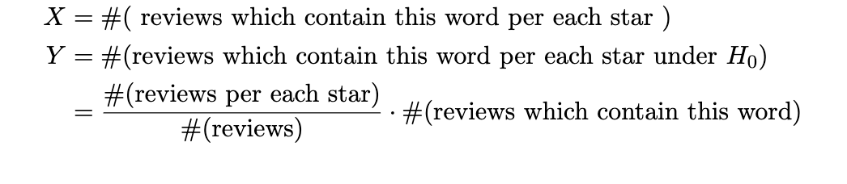
Hypothesis test (chi-squared test)
Note:
We used count number instead of proportion since chi-squared test is sensitive to sample size. The result is not good when sample size less than 50.

Slide 17
Testing results
terms | p-value | terms | p-value
bad | 0.00E+00 | green | 1.62E-06
fresh | 0.00E+00 | rude | 0.00E+00
shrimp | 1.23E-81 | helpful | 1.68E-65
beef | 1.18E-25 | clean | 6.02E-18
chipotle | 2.38E-28 | warm | 1.70E-28

Slide 18
Thank you for your listening!

